Slide 1
Regional Power Generation Predictor
Challenge Title: IBM Hack 2020
Project ID: SPS_PRO_992
Project By-
Siddharth Kulkarni
Yash Vishwakarma

Slide 2
Problem
The wind mill operates at a fixed wind velocity that is the mill doesn’t produce power under the cut in limit of wind velocity and above the cut off limit of wind velocity.
The energy production rate of the wind mill depends highly on the weather conditions. Hence, the amount of energy produced is often inconsistent.(eg- wind mill doesn’t function in thunderstorms etc)
Hence, In order to get consistent energy output we can provide alternative energy sources that may be most efficient in that region.

Slide 3

Solution
To create a mobile and Web Application that will-
Tell us the estimated energy output of the wind mill 72 hours in advance.
Tell us the estimated demand based on the data of the previous month.
Finally it will suggest optimum alternative sources viz. solar/grid in case of shortfall .

Slide 4
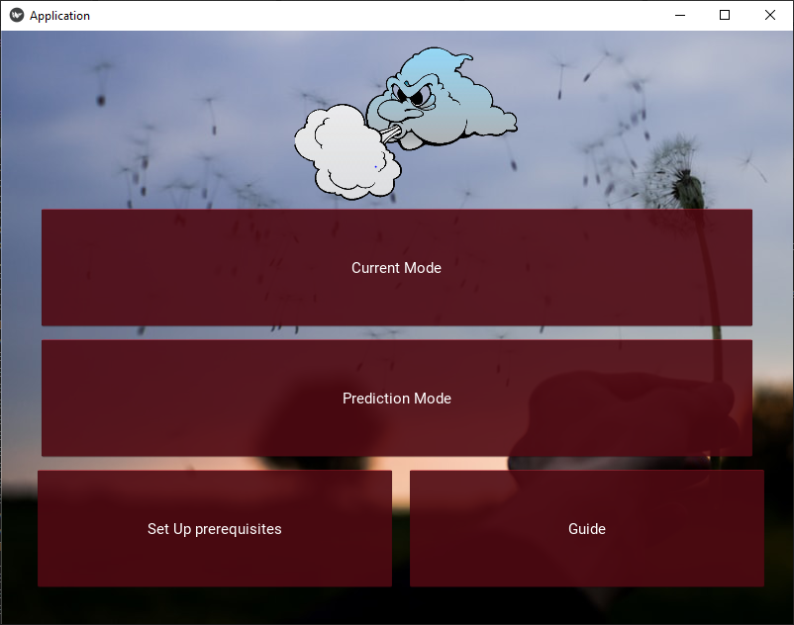
Mobile App
Kivy- Here we are using kivy to create the user interface of the mobile application.
Python3 - The backend of the application is written in python using various modules.

Slide 5
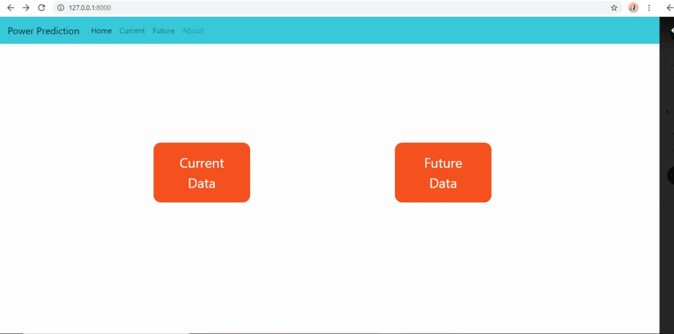
Web App
django- Here we are using django to link the backend of the web app to the front end.
HTML & CSS- We are using HTML and css for the front end of the app.
Backend is written in python3.

Slide 6


